Slide 1

Linux meets robotics

Slide 2
Have you ever seen automated restaurants?

Slide 3
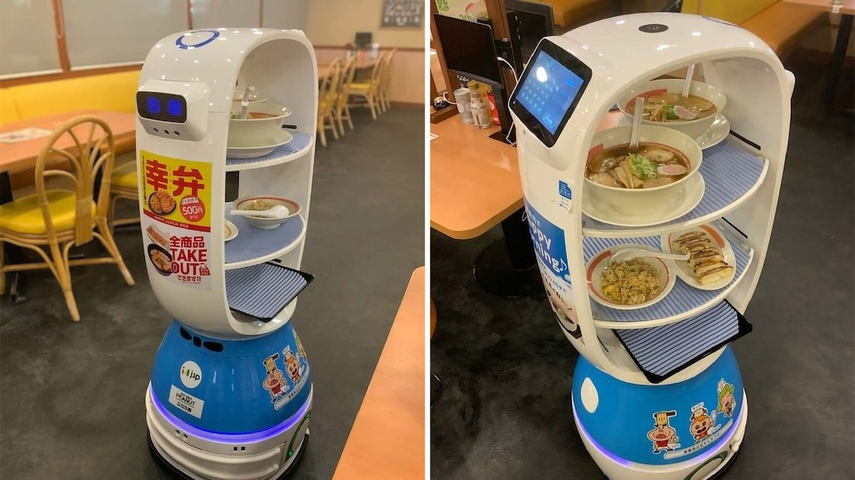

Slide 4
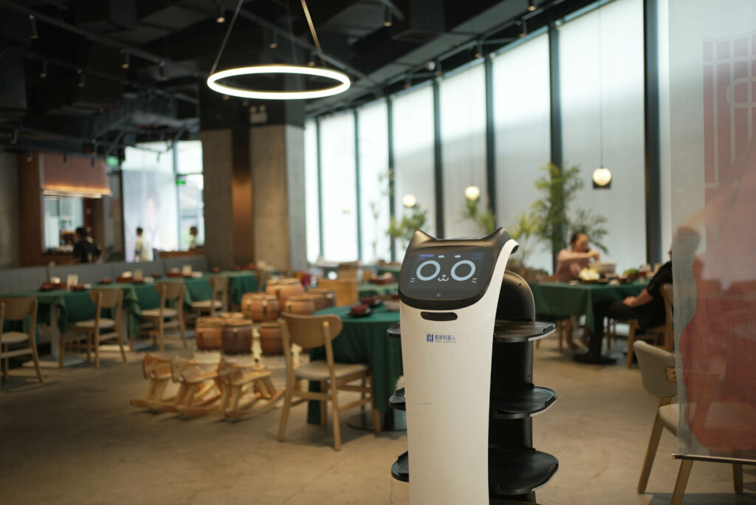

Slide 5
How do they work?

Slide 6
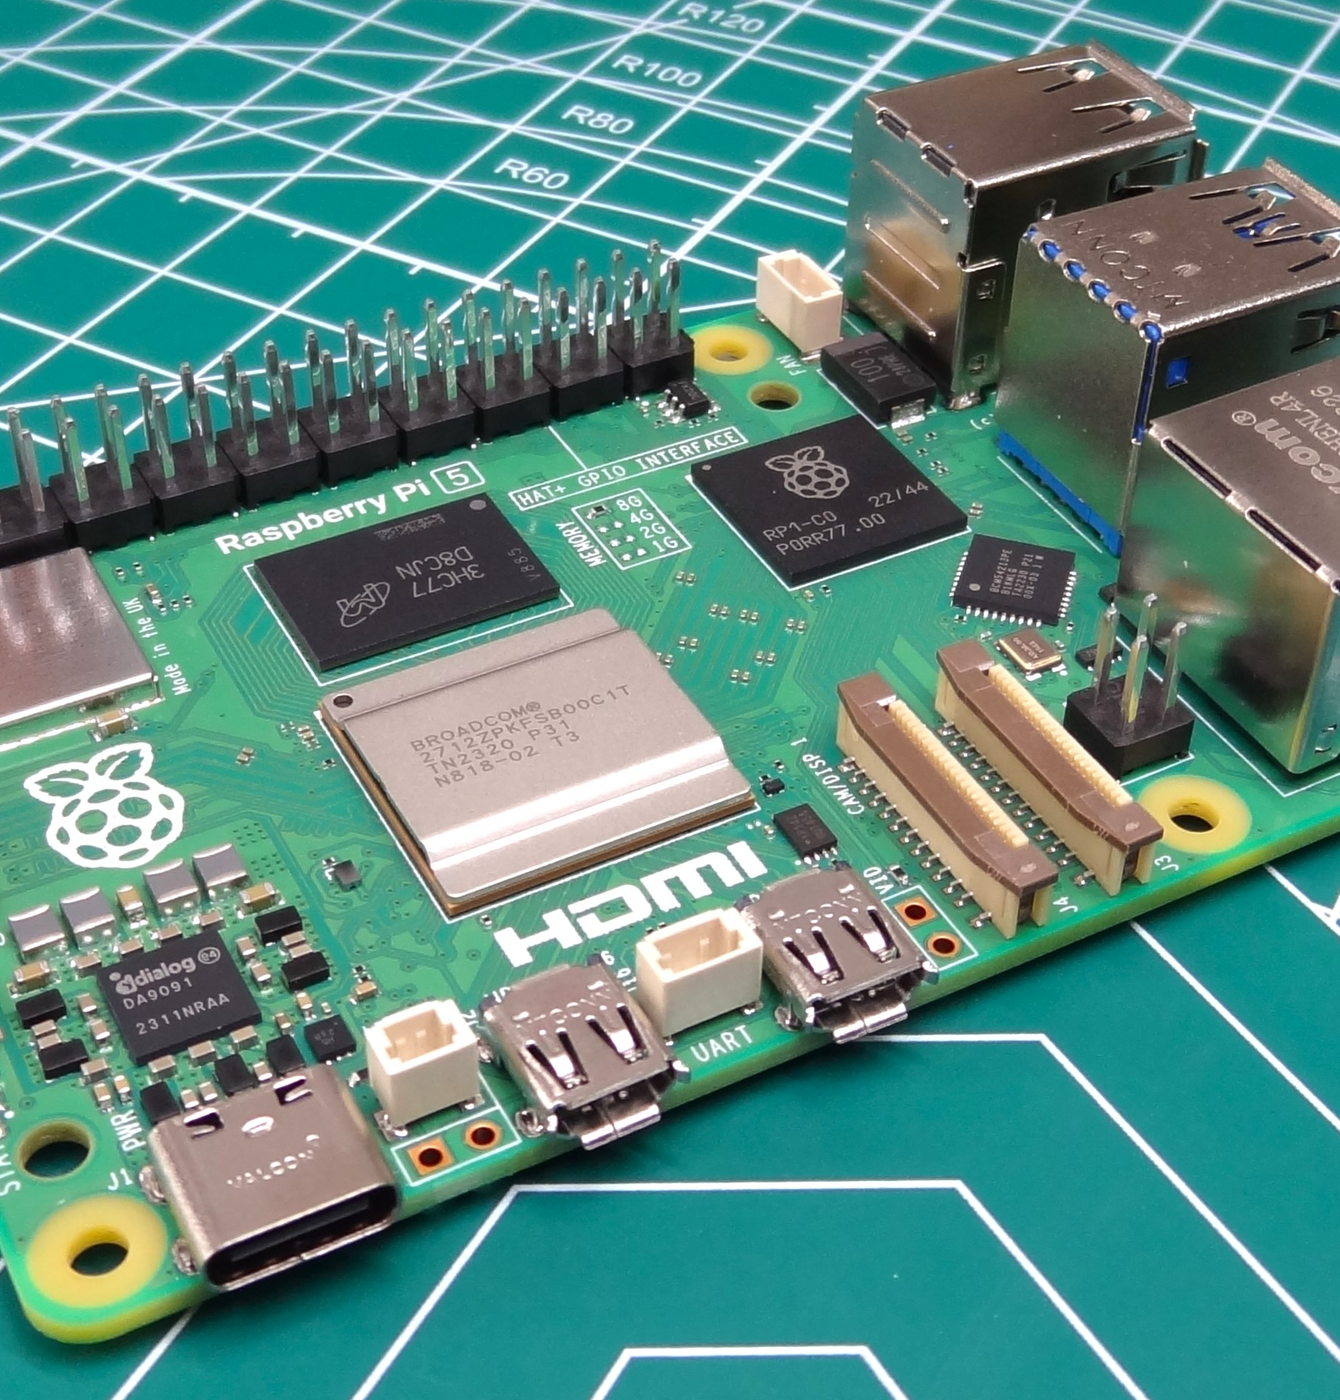
Raspberry pi 5

Slide 7
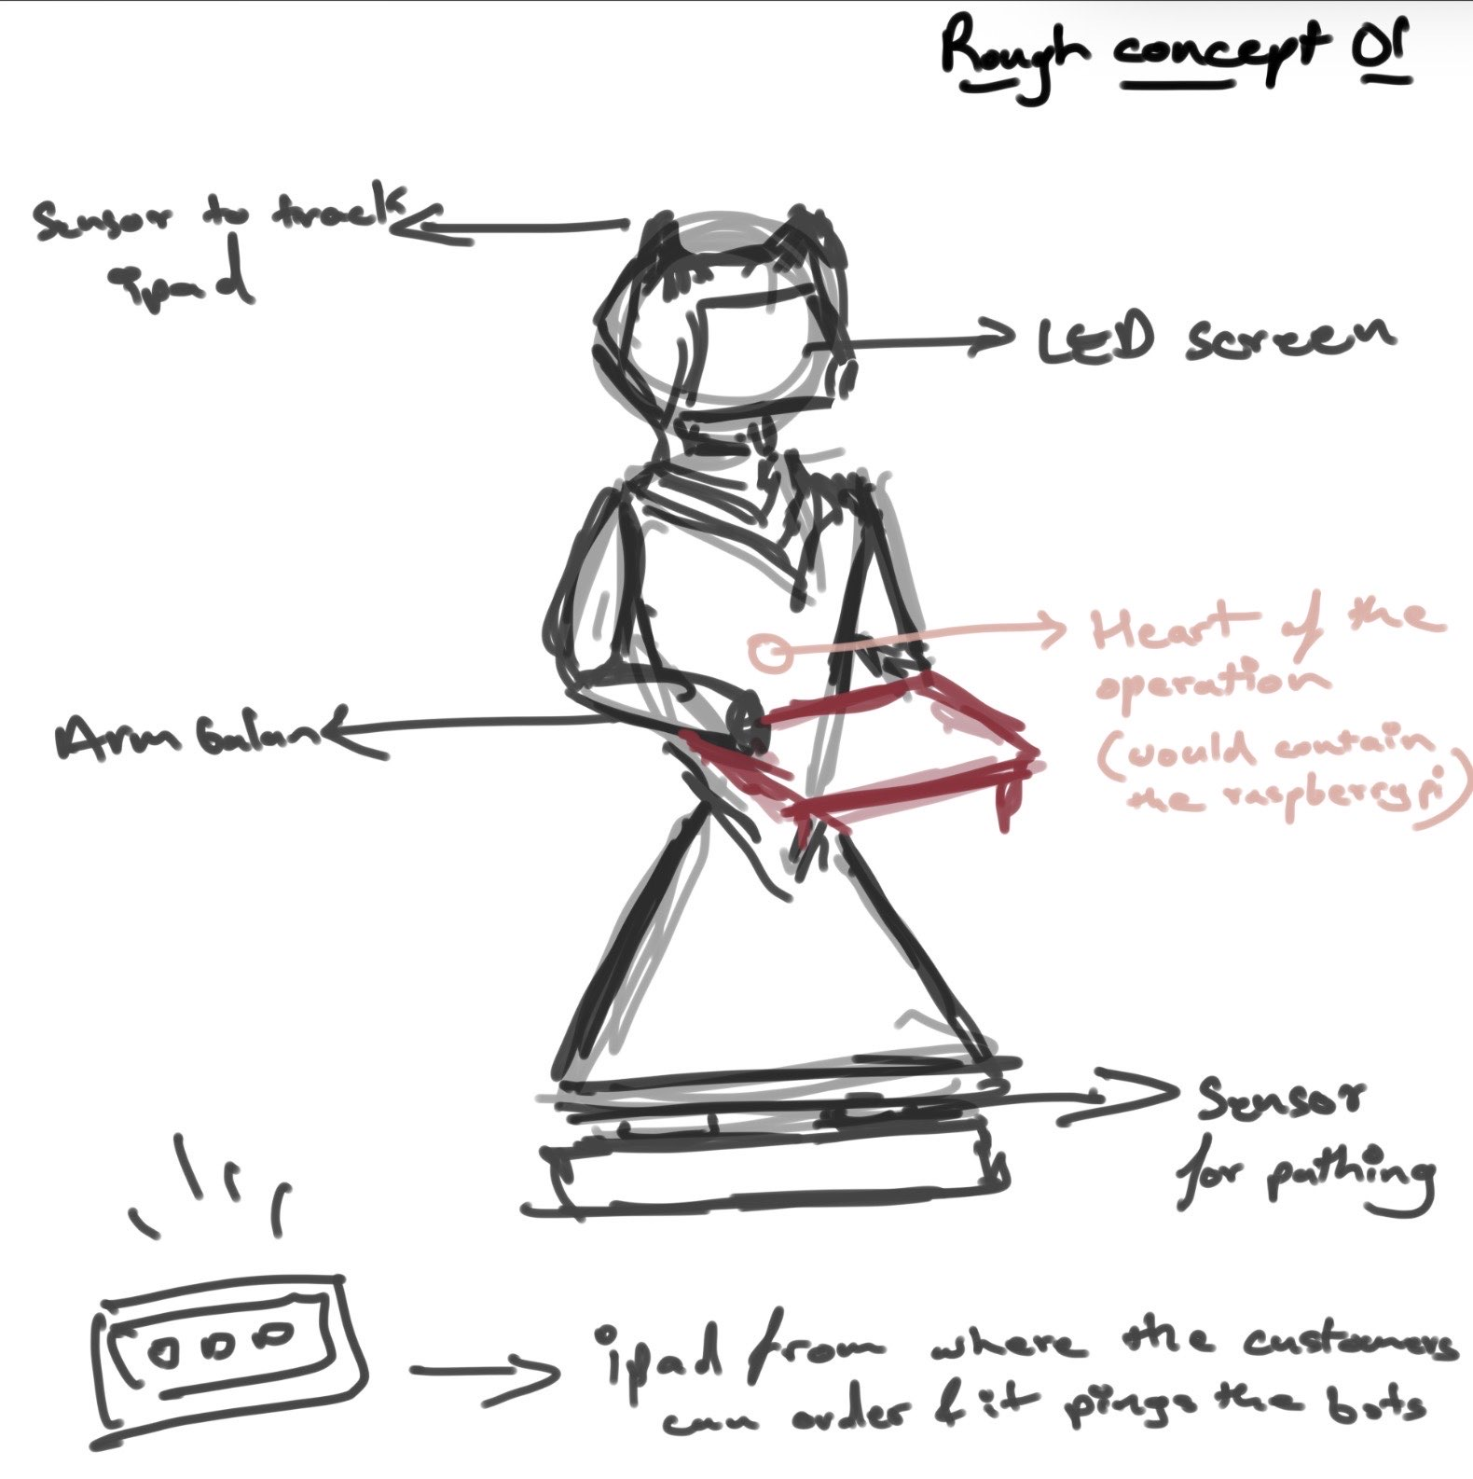
Initial concept.

Slide 8
Two pillars that keep the bot alive.
IPC
SCHED
mq_send(mq, &order_msg, sizeof(order_msg), 0);
The ordering UI and the balancing arm run as independent Linux processes. They communicate via a POSIX message queue (/dev/mqueue). When an order is placed, a structured message is pushed onto the queue — the arm process reads it and adjusts grip stance before movement begins. No shared memory, no race conditions on the data path.
sched_setscheduler(pid, SCHED_FIFO, &sp);
The balancing loop is promoted to real-time scheduling class SCHED_FIFO with the highest priority. The ordering UI runs at default nice value (0). Linux's CFS ensures the balance loop pre-empts the UI if both are runnable — a spill prevention measure at the OS level.

Slide 9
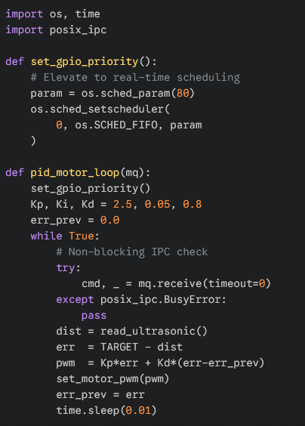
01 Pathing & Sensor System
Specs
Code:
Ultrasonic + IR sensor array for obstacle detection
PID-controlled motor drivers for smooth navigation
Linux kernel handles real-time GPIO via /sys/class
Dedicated OS process at elevated niceness priority

Slide 10
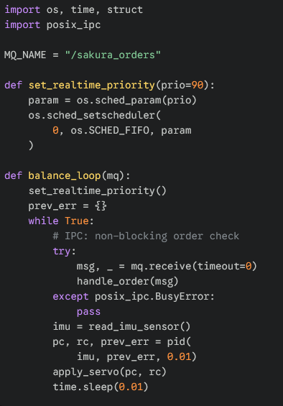
02 Smart Balancing Arm
Specs
Code:
IMU sensor (MPU-6050) samples orientation at 100 Hz
Servo correction loop runs as a high-priority process
Keeps drinks & food level regardless of bot motion
Communicates via POSIX message queue (IPC) with order system

Slide 11
Issues faced
Race Condition: Sensor Write vs. Arm Read
CPU Scheduling Conflict: UI Starving the Balance Loop
GPIO Timing Jitter on Pi 4 (Resolved by Upgrade)

Slide 12
What’s next?

Slide 13
THANK YOU.

